Slide 1

EMERGING AI TRENDS IN CYBER
Phishing Detection
Senthilkumar Dhavasre | S10258427D
Chia Eason | S10257196D

Slide 2


PROBLEM STATEMENT
Can deep learning models effectively distinguish between legitimate emails and spam/phishing attacks using advanced natural language processing techniques, providing automated email threat detection for cybersecurity applications?
Notes:
Phishing is one of the most common entry points for cyberattacks, accounting for around 80–95% of breaches globally.
Every day, over 3.4 billion phishing emails are sent, and although platforms like Google filter over 100 million of them daily, many still slip through (Ghosh, 2025).
What makes phishing so dangerous today is that it’s no longer obvious. Criminals are using AI to create realistic, grammatically perfect messages, fake job offers, and even deepfake voices to impersonate trusted contacts (Baker & Cartier, n.d.).

Slide 3

MOTIVATION & RELEVANCE
Phishing targets everyone, not just companies
Attacks are now AI-crafted, professional, and convincing
Following fake instructions can cause financial and personal damage
Most people lack phishing awareness training
AI offers adaptive, real-time detection against evolving threats
Notes:
Phishing isn’t just a corporate cybersecurity issue, it’s something that affects all of us every day we’re online.
Modern phishing emails are no longer full of typos or obvious mistakes. Many are crafted using AI, making them professional, polished, and extremely convincing. They might look like a message from your bank, your employer, or even a government agency.
The danger doesn’t always come from clicking a link. Sometimes, just following what the email says like transferring money, entering login details, or downloading an attachment — can lead to serious consequences, including financial loss, identity theft, or ransomware infections.
Unlike big companies, individuals don’t have dedicated IT teams watching their inbox. And while phishing awareness training can reduce incidents by up to 86% (Baker & Cartier, n.d.), most people never receive it. Traditional spam filters can also be bypassed with small tweaks like changing a logo or altering a sender’s name.
This is why we built our AI-powered tool, to give everyday users a safety net that learns and adapts to new scams faster than rule-based systems, and can detect even subtle phishing attempts in real time.

Slide 4
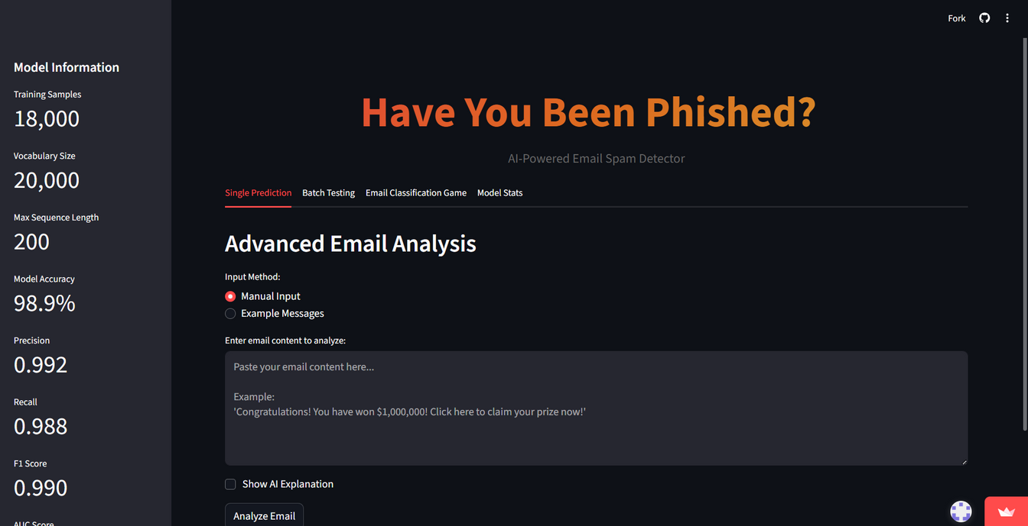
OUR AI SOLUTION
Fast spam/phishing detection
Hybrid model combining NLP & numeric features
Explainable predictions highlighting suspicious words
Includes interactive phishing awareness game
Notes:
Our phishing detection system is built as a hybrid AI model.
The first part is Natural Language Processing (NLP) using an LSTM neural network to analyze the actual text of emails, spotting suspicious word patterns, tone, and phrasing.
The second part looks at numeric “spam clue” features, like how many links are in the email, how much punctuation is used, whether there are currency symbols, or if there’s an unusual amount of capital letters.
By combining these two streams of information, the model doesn’t just flag obvious scams. It can catch subtle, well-crafted phishing emails that traditional spam filters often miss.
We packaged this into an easy-to-use Streamlit web application so anyone can paste in an email and get an instant spam/ham classification. Results are shown with confidence scores, and we also provide visual explanations of which features influenced the decision the most.
Beyond detection, we’ve added a small interactive game where users can practice identifying phishing emails. This makes the app educational, helping people learn to spot scams themselves, even without the AI’s help.

Slide 5

DATASET USED
Source: Phishing Email Dataset by Naser Abdullah Alam (Kaggle)
The dataset contains ~82,500 emails
42,891 spam/phishing
39,595 legitimate (ham)
Composition:
Combines multiple well-known datasets (Enron, Ling, CEAS, Nazario, Nigerian Fraud, SpamAssassin)
Includes both simple and highly sophisticated phishing emails
Why we didn’t use the pre-combined CSV:
The “phishing_email.csv” file contains extra metadata such sender info, timestamps) that’s not needed for our model
We combined the 6 source CSVs ourselves to keep only relevant text + labels

Slide 6
HOW OUR AI SOLUTION WORKS
Data Collection + Preprocessing
Feature Extraction
Model Training
Deployement
Evaluation

Slide 7
Processed Messages
6 Numeric Clues
Embedding Layer - 128 dimensions
Dense Layer (32) + ReLU Activation
Dense Layer (32) + ReLU Activation + Dropout (0.3)
LSTM Layer (64) + Dropout (0.6)
OUR MODEL ARCHITECTURE
Dense Layer (64) + ReLU Activation + Dropout (0.6)
Output Layer - Sigmoid
Phishing Probability

Slide 8
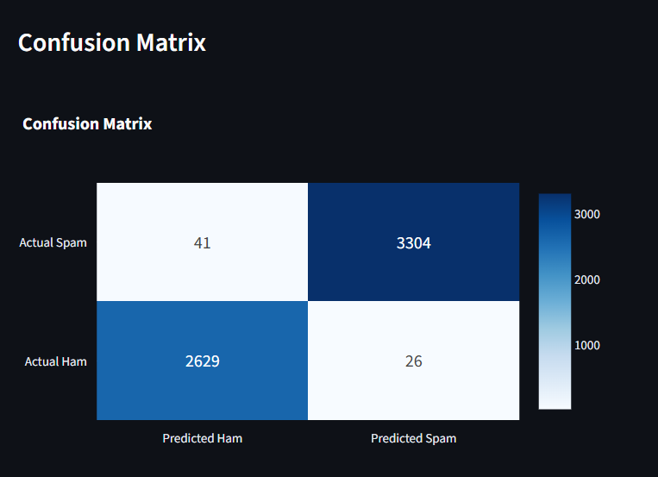
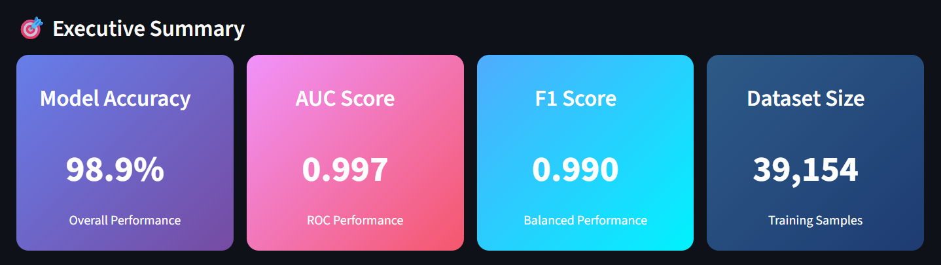
OUR MODEL EVALUATION
Accuracy of 98.9% means that model correctly classifies most emails.
AUC Score was 0.997 displaying excellent ability to separate spam from ham.
The F1 Score was 0.990, which shows strong balance between precision and recall.
Confusion Matrix shows very few misclassifications; majority of spam/ham predicted correctly.

Slide 9
SINGLE PREDICTION TAB
explain_prediction
predict_spam_messages
Single Prediction Streamlit Front End

Slide 10
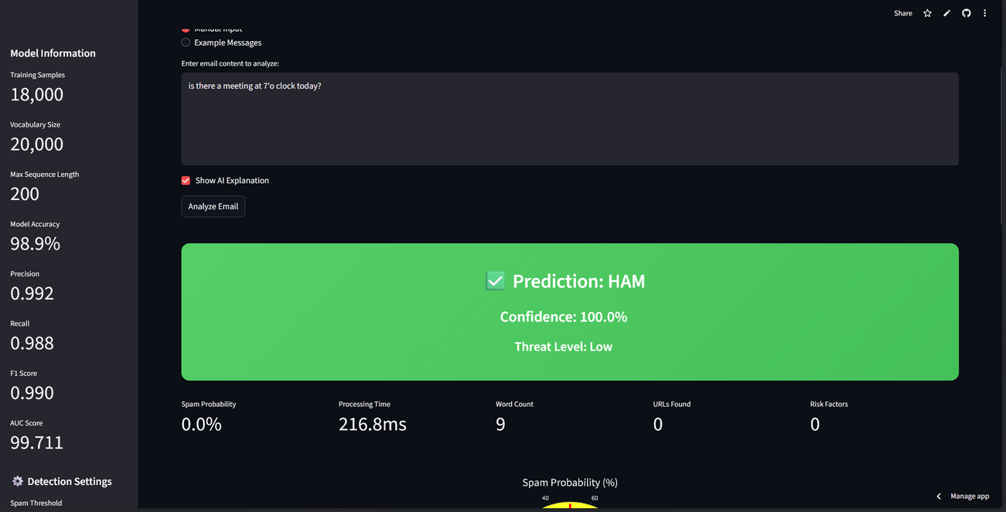
CORE PREDICTION ENGINE
Input validation & performance timing
Configurable threshold classification
Risk factor analysis & threat level assignment
Comprehensive result dictionary output
7-feature array: URLs, punctuation, caps ratio

Slide 11
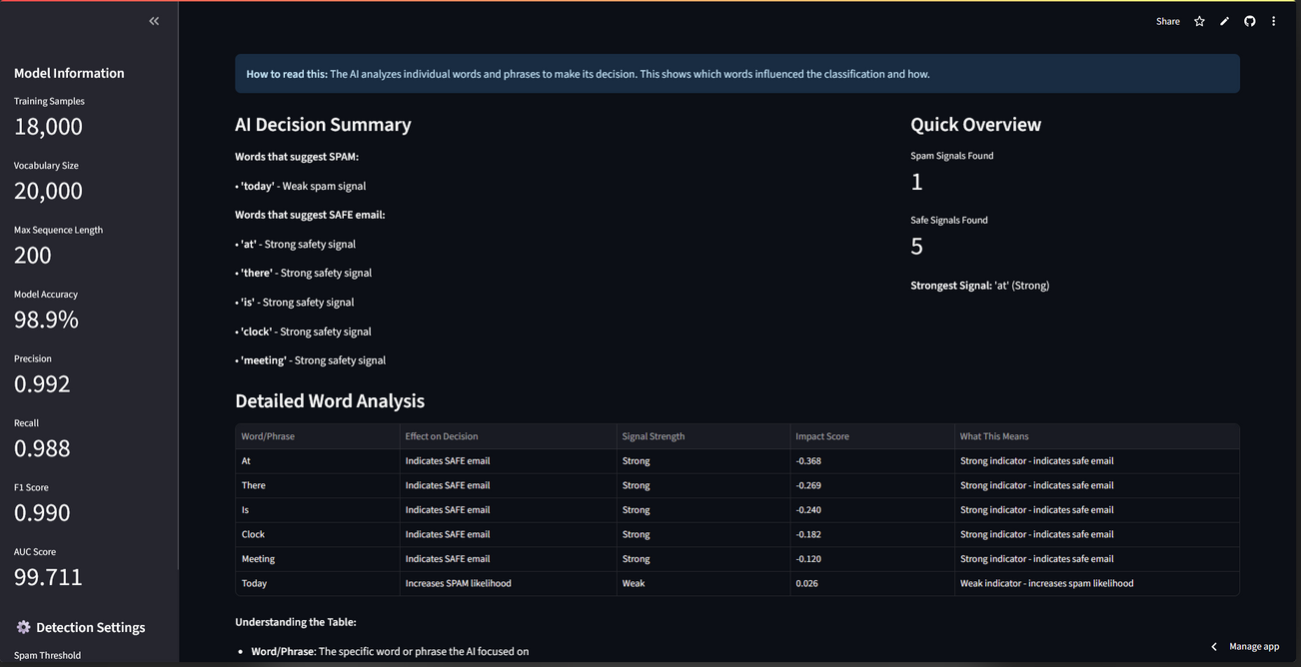
AI EXPLANATION ENGINE
LIME-based model interpretability system
Split on non-word characters, preserves context
Cosine distance metric for semantic similarity
Returns explanation object for user interface
Robust error handling with graceful degradation

Slide 12
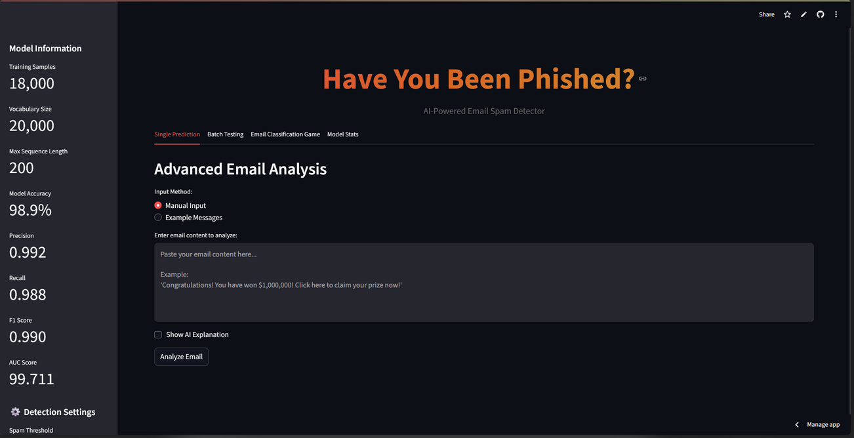
SINGLE PREDICTION TAB
Dual input methods: manual entry & example messages
Calls predict_spam_message() with threshold setting
Dynamic result display with color-coded prediction boxes
Interactive probability gauge & detailed metrics
Optional AI explanations via explain_prediction()

Slide 13
BATCH TESTING TAB
predict_spam_messages
Single Prediction Streamlit Front End

Slide 14
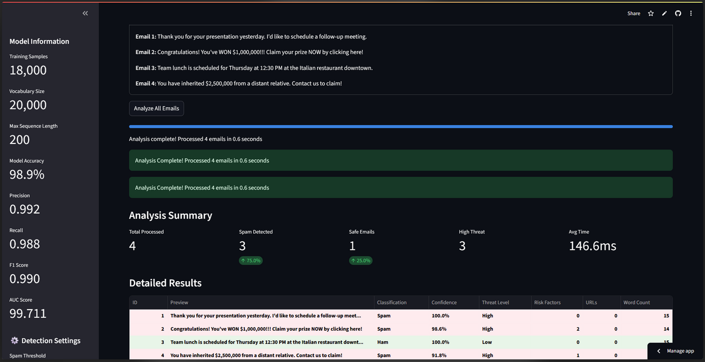
BATCH TESTING INTERFACE
File upload widget with TXT format validation
Automatic email parsing (one per line)
Bulk predict_spam_message() processing loop
Color-coded results table with spam/safe highlighting
CSV export functionality with timestamped files

Slide 15
EMAIL CLASSIFICATION TAB
get_random_test_email
game_explanation
predict_spam_messages
Email Classification Game Front End

Slide 16
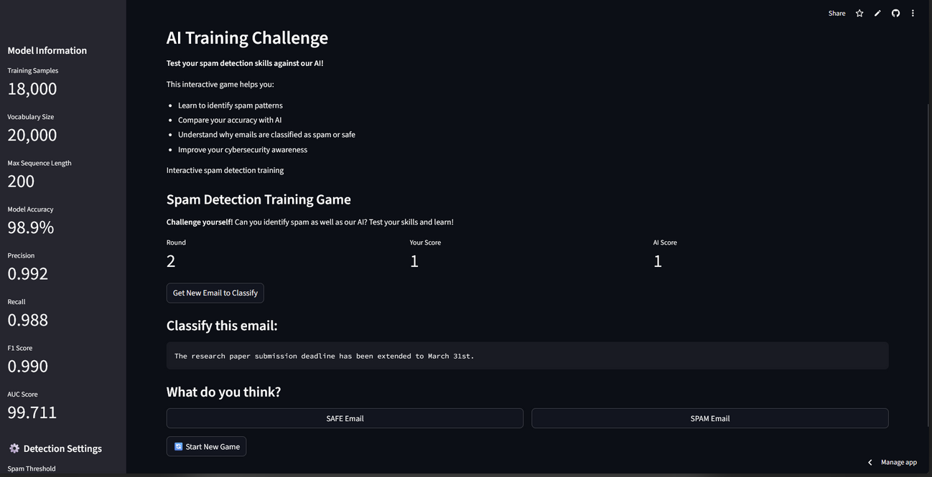
TRAINING EMAIL GENERATOR
Curated spam & legitimate email dictionaries
Random category selection (spam/safe)
Random email selection within category
Returns structured data with content & labels
Clear classification ground truth provision

Slide 17
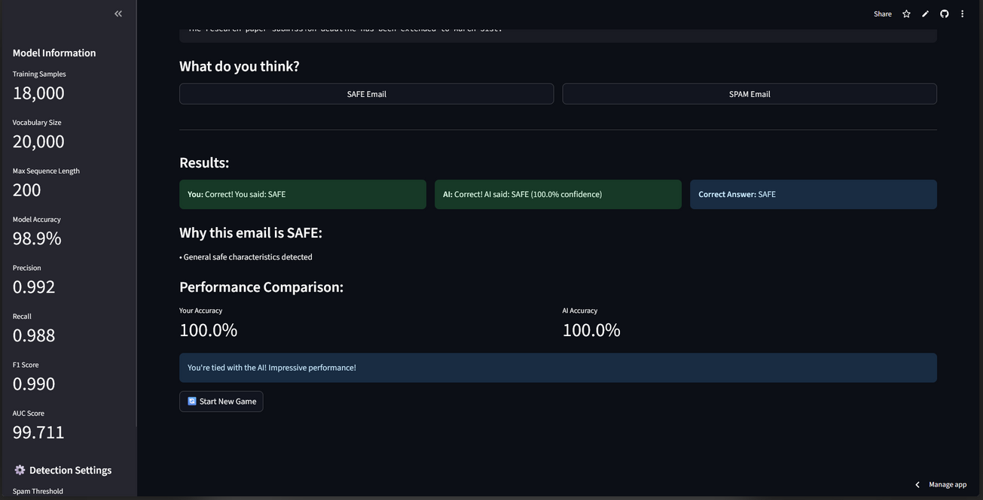
EDUCATIONAL FEEDBACK GENERATOR
Pattern-based email analysis for learning
Keyword detection & threat indicator matching
Contextual educational content generation
Automatic spam characteristic identification
Dynamic explanation selection based on content

Slide 18
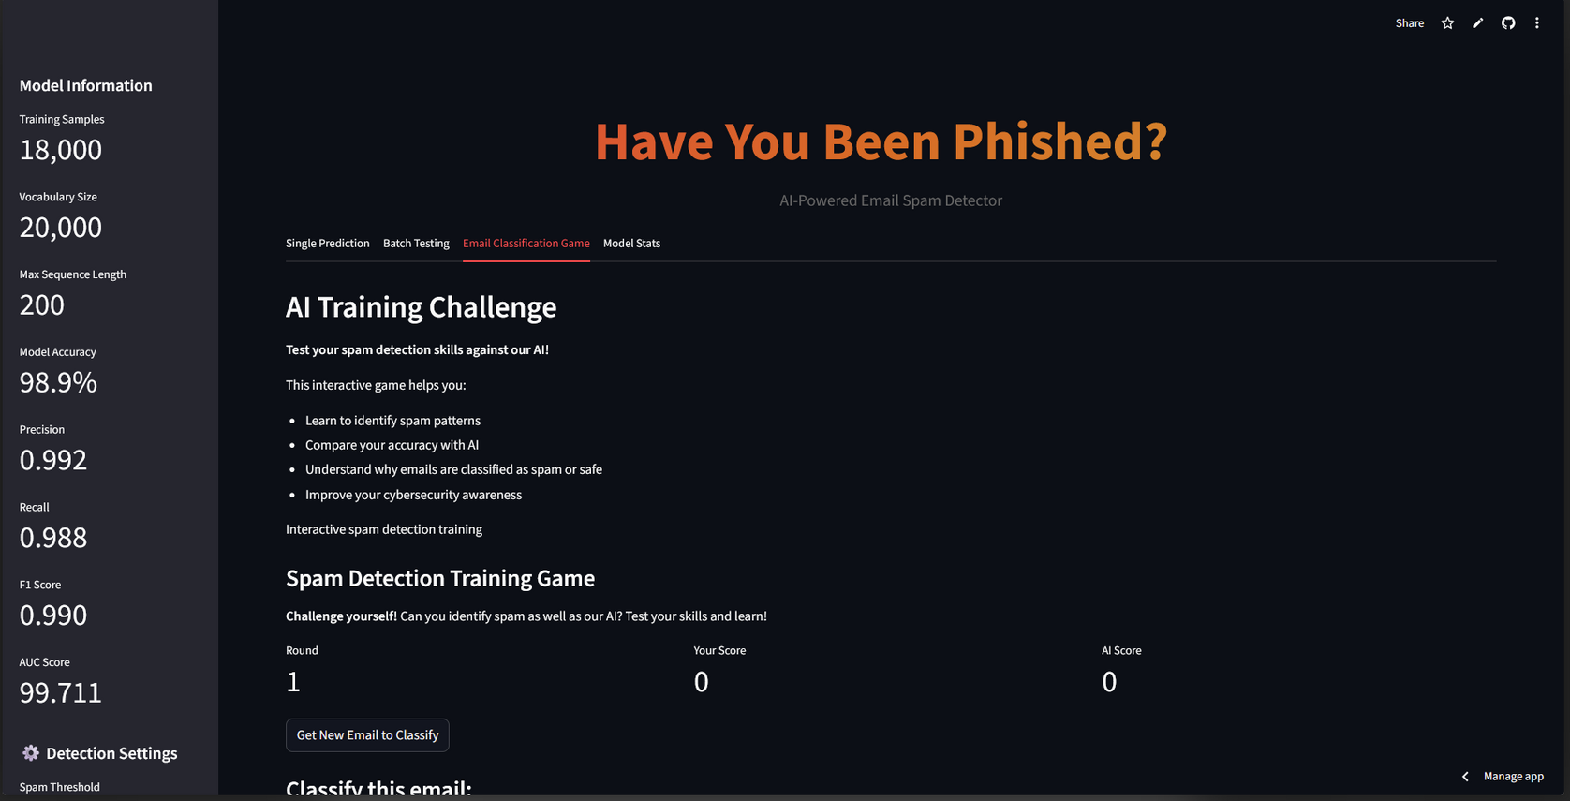
EMAIL GUESSING GAME TAB
Interactive game state management with session tracking
get_random_test_email() integration for diverse challenges
Binary classification buttons (SAFE/SPAM) with scoring
Real-time predict_spam_message() for AI comparison
Comprehensive game_explanation() feedback system

Slide 19
CONCLUSION
WHAT WE ACHIVED?
TECHNICAL IMPACT
Successfully developed AI-powered email spam detection system
Achieved 97.9% accuracy with hybrid LSTM + feature engineering
Built comprehensive Streamlit web application with 4 functional tabs
Implemented explainable AI with LIME for transparency
Advanced cybersecurity threat detection capabilities
Real-time email analysis with sub-200ms response times
Comprehensive user education through gamified learning
Production-ready system with robust error handling

Slide 20
THANK YOU!
FOR YOUR ATTENTION

